Slide 1

Capstone Project-3 on Health Insurance Cross Sell Prediction
Individual done by Monica Patel (Under the Guidance of Team Alma better)

Slide 2


Slide 3
Table of content
Importing the Dataset and Relevant Libraries
Data Inspection
Exploratory Data Analysis
Visualization
Feature Selection
Feature Engineering
Train and Test split
Model Training
Model Testing
Hyper-parameter Tuning
Cross Validation
Conclusion (with key and improvement points)

Slide 4
Problem Statement
Our client is an Insurance company that has provided Health Insurance to its customers now they need your help in building a model to predict whether the policyholders (customers) from past year will also be interested in Vehicle Insurance provided by the company.

Slide 5
Data Description
➢ The Dataset provided consisted of 381109 rows and 12 columns. ➢ There were zero duplicates and null values in the Dataset.

Slide 6
Data Set Information
Columns Used:
1. Id- Unique ID For The Customer
2. Gender - Gender Of The Customer
3. Age- Age Of The Customer
4. Driving_license- 0 : Customer Does Not Have DL, 1 : Customer Already Has DL
5. Region_code - Unique Code For The Region Of The Customer
6. Previously_insured- 1 : Customer Already Has Vehicle Insurance, 0 : Customer Doesn't Have Vehicle Insurance
7. Vehicle_age- Age Of The Vehicle
8. Vehicle_damage - 1 : Customer Got His/Her Vehicle Damaged In The Past. 0 : Customer Didn't Get His/Her Vehicle Damaged In The Past.
9. Annual_premium - The Amount Customer Needs To Pay As Premium In The Year
10. Policysaleschannel - Anonymized Code For The Channel Of Outreaching To The Customer Ie. Different Agents, Over Mail, Over Phone, In Person, Etc.
11. Vintage - Number Of Days, Customer Has Been Associated With The Company
12. Response (Target)- 1 : Customer Is Interested, 0 : Customer Is Not Interested

Slide 7
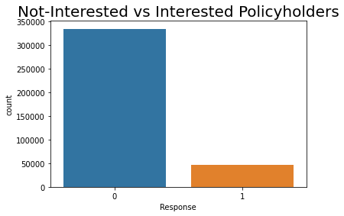
Checking the Balanceness of dataset
Observation
As we can see in this count-plot that our data is unbalanced so we have to make it balanced. For that we used Over-sampling, Under-sampling and SMOTE as well but Oversampling gives promising results than others, So we will proceed further with this technique only.

Slide 8
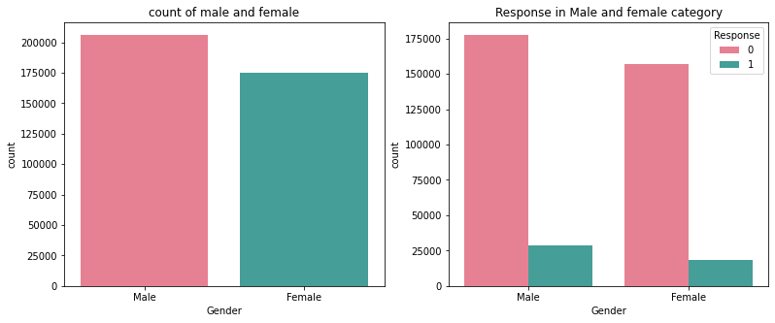
Visualization
As we can see from below plots we have more number of men than women so we have a gender-gap here.
And as a results males have more interested than female in their vehicle insurance so we have to target woman more for increasing conversion of women.
Dropping T9, RH_4, RH_5, months, Tdewpoint, Visibility, rv1, rv2 and week_days columns.

Slide 9
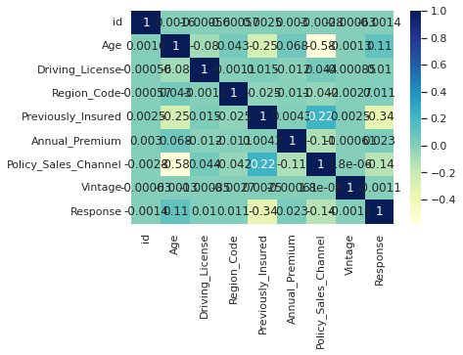
Correlation of features
Multivariate analysis
To find a correlation between features
There is no strong correlation among features as we can see from this heatmap

Slide 10
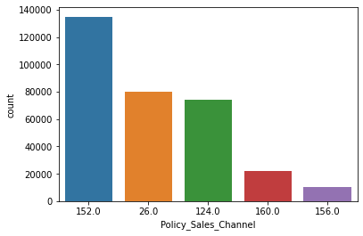
Observations based on correlation plot
As we can see that no features have highly positive correlation with each others.
Gender_male and gender female have highly negative correlation so we can remove one of them.
We have some a small correlation of vehicle_damage with our target feature.
We have some negative correlation of our target feature with previously_insured, vehicle_age and policy_sales_channel.
Vehicle_damaged and previously_insured features have highest negative correlation.

Slide 11
EDA
Response (Dependent Variable) ● Response :1:Customer is interested, 0 :Customer is not interested
Gender of the customer Vs. Response ● From below plots we can see number of men is bit more than women, so we have a little gender-gap here. ● Males seems to have more interest in vehicle insurance than women so we have to target woman more to increase conversion rate of women for vehicle insurance.
Customer without a driving license is just 0.2% of all customer, we can conclude that almost every customer has a driving license.

Slide 12
Gender of the customer Vs. Response ● From below plots we can see number of men is bit more than women, so we have a little gender-gap here. ● Males seems to have more interest in vehicle insurance than women so we have to target woman more to increase conversion rate of women for vehicle insurance.

Slide 13
(Driving_License) Customer without driving license is just 0.2% of all the customer, we can conclude that almost every customer has driving license.

Slide 14
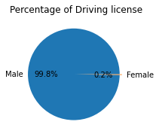
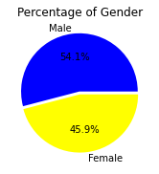
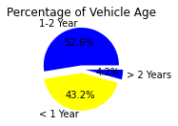
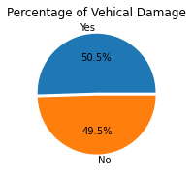
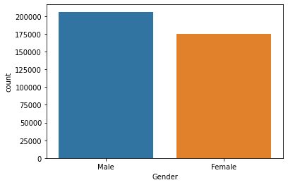

Slide 15
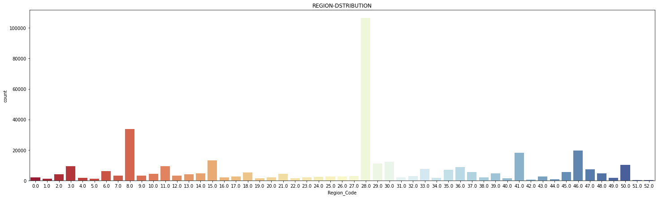
Region 28 has highest number of customer interest in vehicle insurance

Slide 16
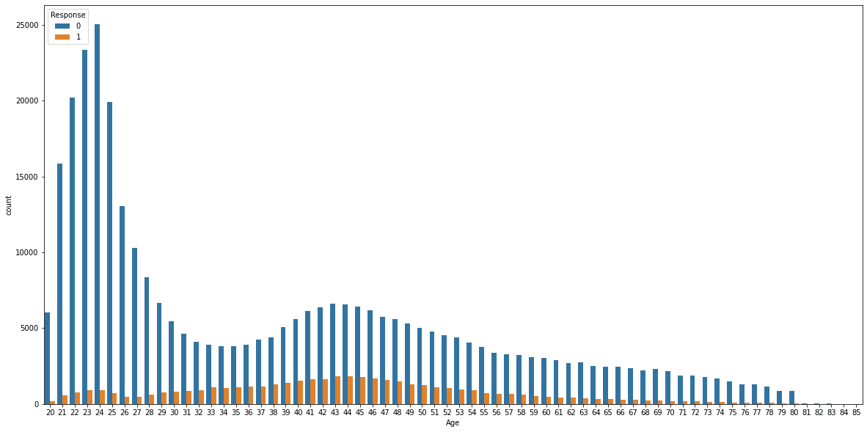
Here we can see customers in 30s-60s are most interested in vehicle insurance, which is quite natural as matured generation are aware of insurance and its benefit

Slide 17
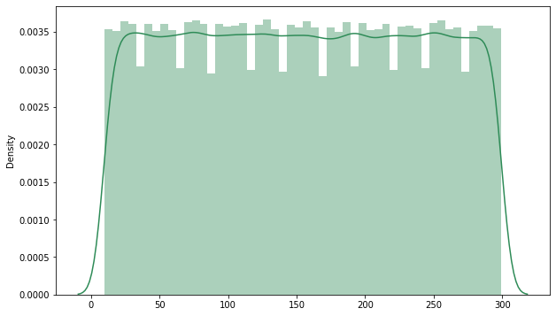
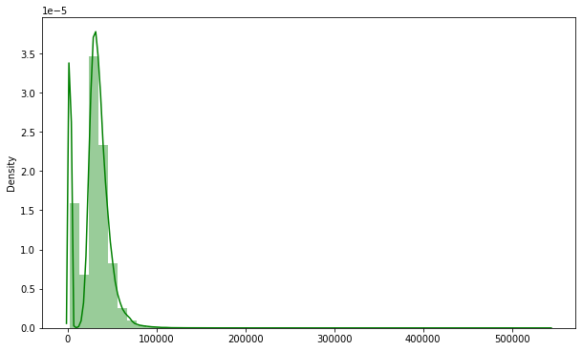
Number of Days, Customer has been associated with the company ● There seems to be no such relation between vintage and response

Slide 18
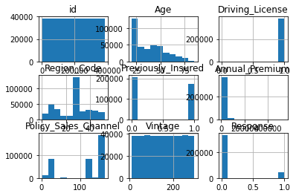

Slide 19
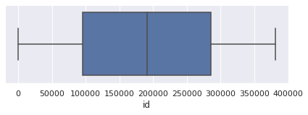
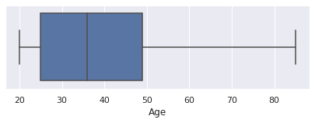
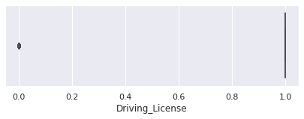
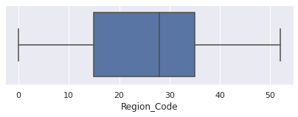
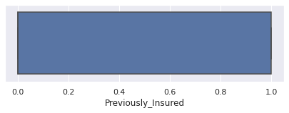
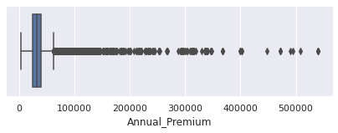
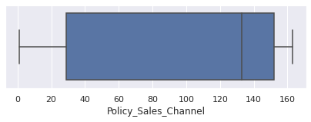
Here we check for outliers in each FeatureHere we check for outliers in each Feature Annual premium feature contains outliers so we transform annual premium to normal distribution

Slide 20
Train –Test Split ● After applying Smote to balance the data, we now fit dataset to train- test split for training and testing purpose(model evaluation). Model Selection M odels we will be using here are: ● Logistic Regression ● Decision Tree ● Random Forest ● XGBClassifier

Slide 21
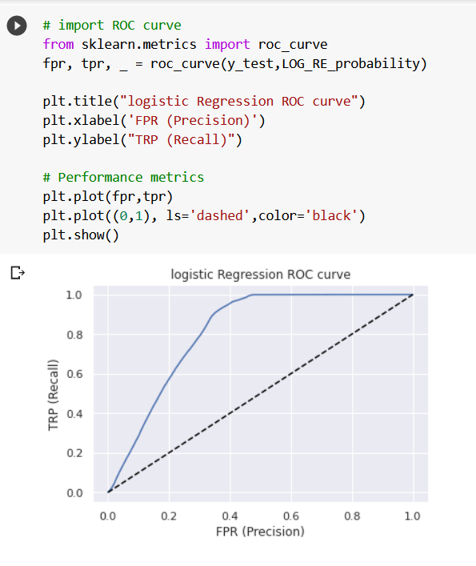
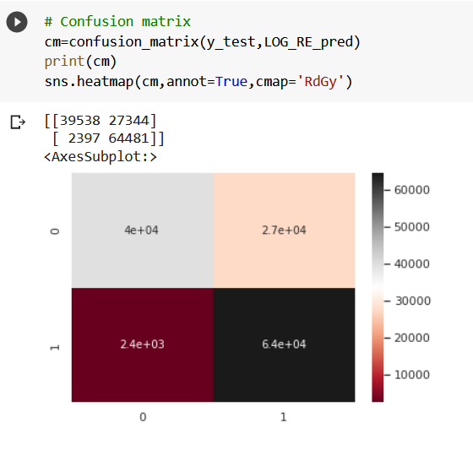
Logistic Regression

Slide 22
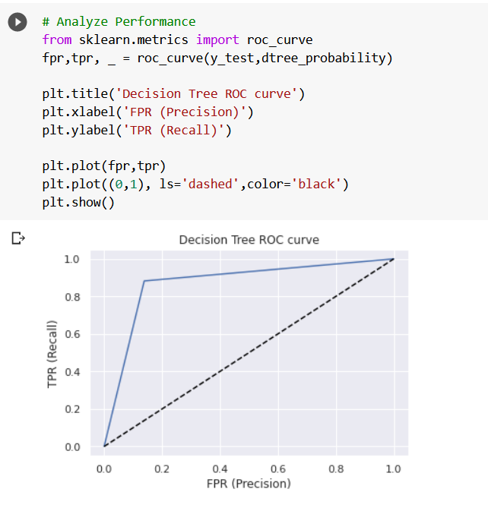
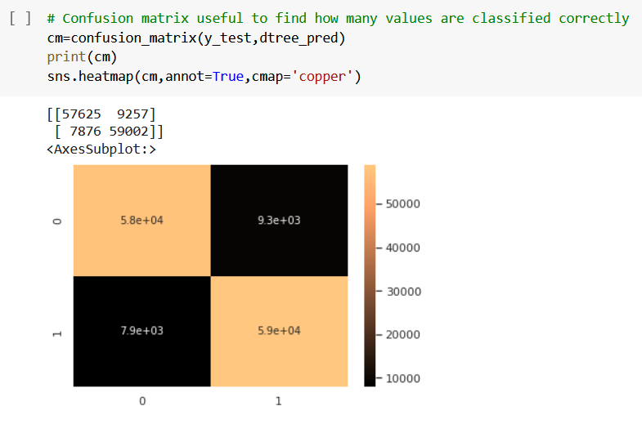
Decision Tree

Slide 23
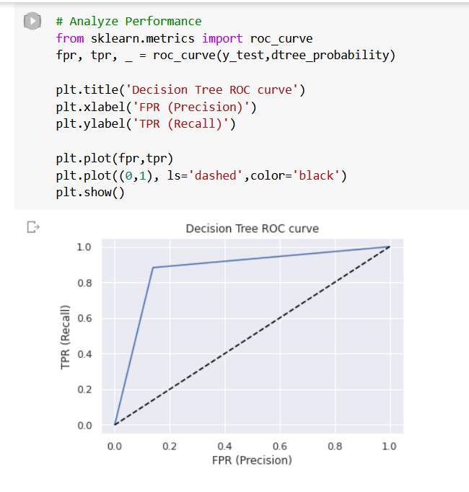
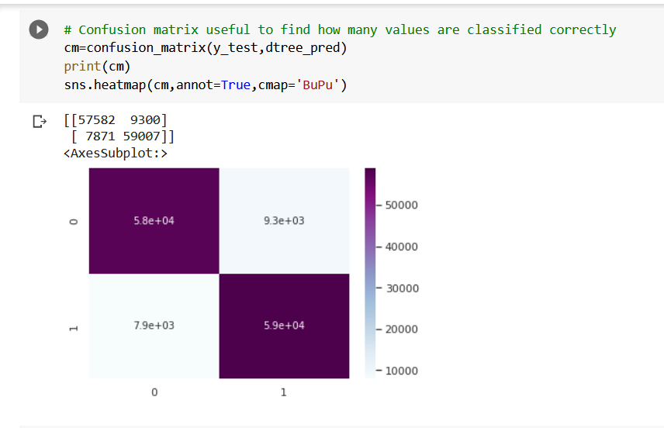

Slide 24
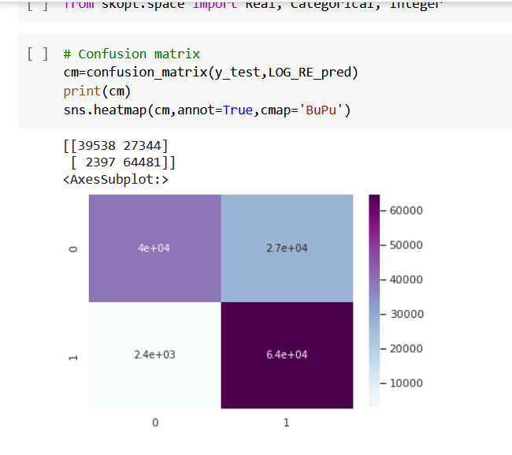
Random Forest

Slide 25
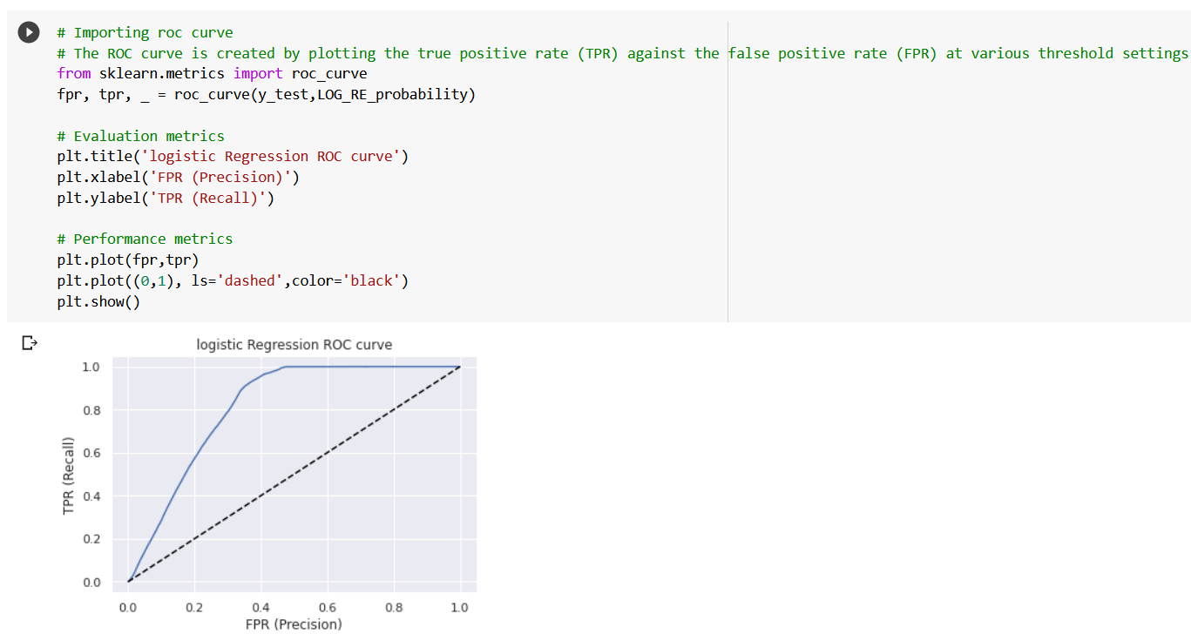
LOGISTIC REGRESSION

Slide 26
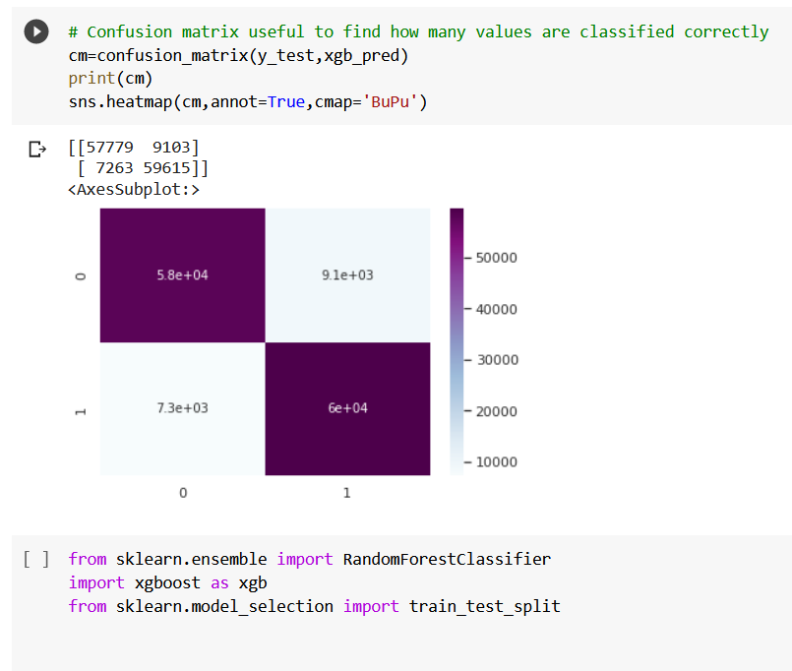
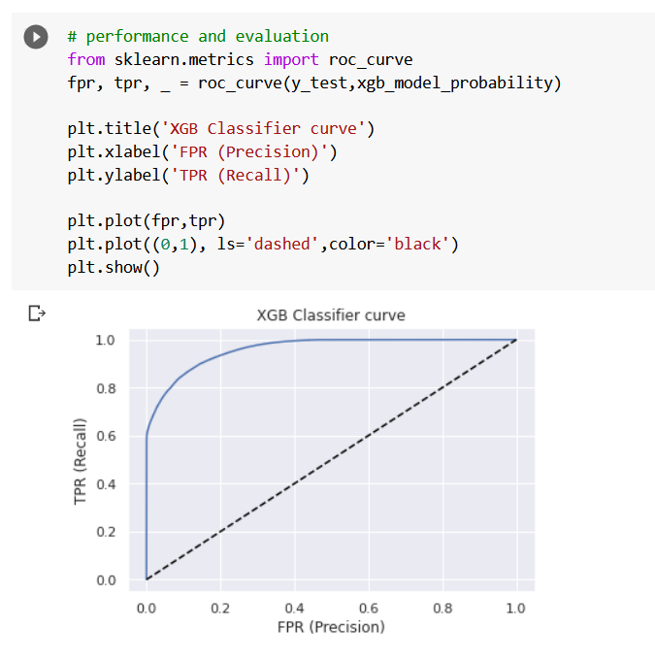
XGB Classifier

Slide 27
CONCLUSION
Customers of age between 30 to 60 are more likely to buy insurance.
Customers with Driving License have higher chance of buying Insurance.
Customers with Vehicle_Damage are likely to buy insurance.
The variable such as Age, Previously_insured,Annual_premium are more afecting the target variable.
comparing ROC curve we can see that Random Forest model preform better
. Because curves closer to the top-left corner, it indicate a better performance
the customers who have driving licences will option for insurance instead of those who don’t have it ● Consumers with 1-2-year-old vehicles are more interested in buying insurance. as compared to Consumers with less than 1-year-old Vehicles ● Customers with Vehicle_Damage are likely to buy insurance as they have experienced the expenditure in repairing vehicles The variable such as Age, Previously_insured, Annual_premium is more affecting the target variable.

Slide 28


